Slide 1
Link to slide:
https://drive.google.com/file/d/1prWNg3sweujEbBYg4NTdQTZdZzlk14JM/view?usp=sharing

Slide 2
Hello Guys,
Today, I going to present a topic that is very interesting
before we start, can you guys tell what movie is this?
I wait for few seconds
->
well, hopefully you guys guess it rgt,
this is the movie Dawn of the planet of the apes. it is an old movie but why do I show this?
->
it is because I am going to discuss human and wildlife relationship
which is the topic of the op-ed that I have wrote
now ask yourselves this question, have you guys communicate with animal bf?
well most of you who have domestic pet will probably say have,
but how about animal that is not domestic but still commonly seen in Singapore
for example, monkeys and wildboar, what are your thought about them?
animal and human are creatures habiting earth but as humanity progress, we now
live in modern city
and the distance between us and the animal grew more distant due to difference in
our culture, characteristic and existance of communication barrier.
however animals such as monkey, wildboar, snakes
are still often seen in certain place in singapore
->
Which bring us toward why I am explaining this, it is because we are going to
look into how we can
create an enviroment where human and wildlife can coexist?
->
First we take alook from wildlife perspective as understanding
how wildlife perceive humans
is essential in resolving human and wildlife conflict
->
from an E-book published in 2020, a writer goumas has researched and conclude that
animal responses toward human are based on their prior experience and what
animal identify human
->
***
This is how the wildlife cognitive process works in interaction with human
Goumas has mention that most of all intitial encounters with human will result in
negative impretion due to fear factor of animal instinct
and progress depend on which impression the get from human, repetitive
positive impression
will lead to wildlife perceiving human as rewarding individual
while repetitive bad impression will lead to increase of the animal stress level that
impact badly to the animal such as decrease in reproduction rate
->
Now after understanding the wildlife view,
we need to understand how human view about wildlife
according to a journal article published in 2019 that research about
the attitude and tolerance of Singapore residents toward the wildlife in Singapore.
its actually shows that attitude towards common seen problem-causing wildlife in singapore
such as monkeys,hornet,snakes etc
was largely neutral or negative
an online survey was conducted and out of 1004 Singapore residents aged
between 18-69 years old
502 males and 502 females
the result of the survey is
about 52% of respondents had negative feelings towards hornets and snakes
and 14% of respondents had negative feelings towards macaques
Female respondents had significantly more negative attitudes towards
the three animals compared to males
What is the solution?
lets take alook at another online survey from the same journal article,
55.3 % of respondents
seldom / never played in natural environments or
engaged in nature-related activities in their childhood
and
15.5% of respondents reported frequent visits to
and played in natural environments in their childhood
this shows that children experience with wildlife and nature are low
->
according to Ngo who is the writtetr of the journal,
childhood experiece is important to have positive relationship to
enviromental attitudes and behaviours
->
in conclusion
First, It is essential to remove the hostile impression human have toward wildlife
because it could lead to negative activities toward wildlife.
Since humans possess better cognitive reasoning,
humans should be more open and accepting toward wildlife and
put effort into establishing effective wildlife management programs that educate and
encourage the public starting from a young age
to exhibit positive interactions with wildlife as a culture
which will lead to wildlife perceiving us as rewarding individual rather than a threat
These actions are a forward step toward humans and animals coexisting.
Thanks you for listening

Slide 3

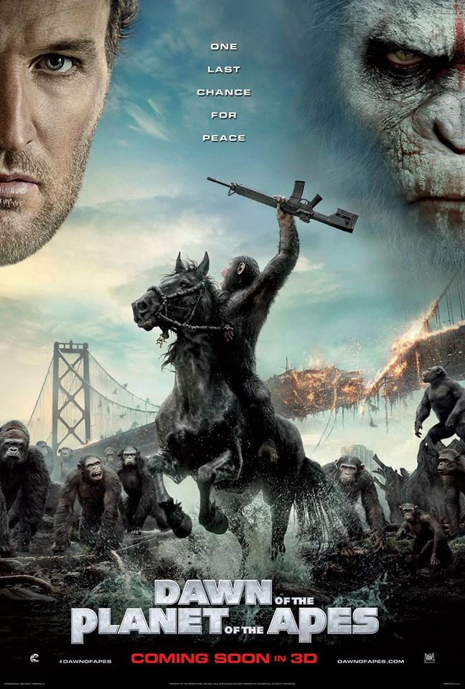
What is this movie?

Slide 4

Taking a Walk in Nature
CC0001 Hendy T145

Slide 5
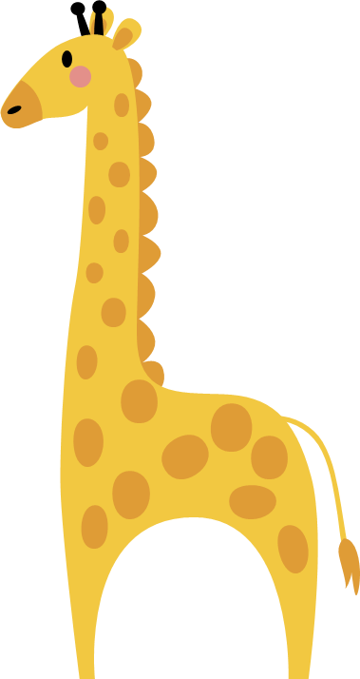

Problem Statement
how we can create an environment where human and wildlife can coexist?

Slide 6

(Goumas et al., 2020).
"understanding how wild animals perceive humans may help minimize
wildlife disturbance and allow the implementation of more effective conservation strategies"

Slide 7
(Goumas et al., 2020).
"Animals' responses to humans are based on previous encounters with other humans, and the experience requires some level of generalization of what was learned during these prior experiences to influence response toward humans, and animals can only habituate to humans if they identify humans as being members of the same category"

Slide 8





Wildlife Cognitive process during interaction
Initial encounter
Positive
impression
Negative impression
View Human as rewarding individual
Stress level increase

Slide 9
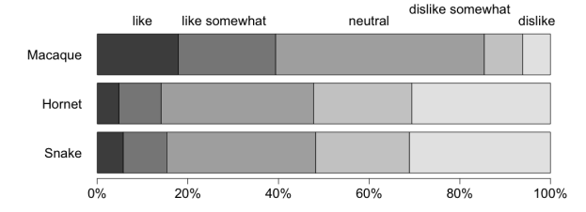
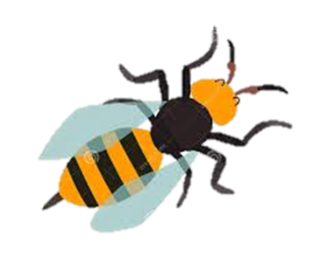
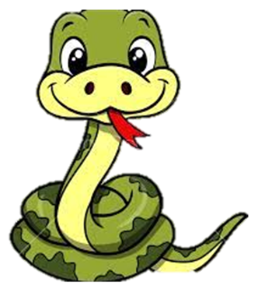
Survey about impresion on selected wildlife results

Slide 10
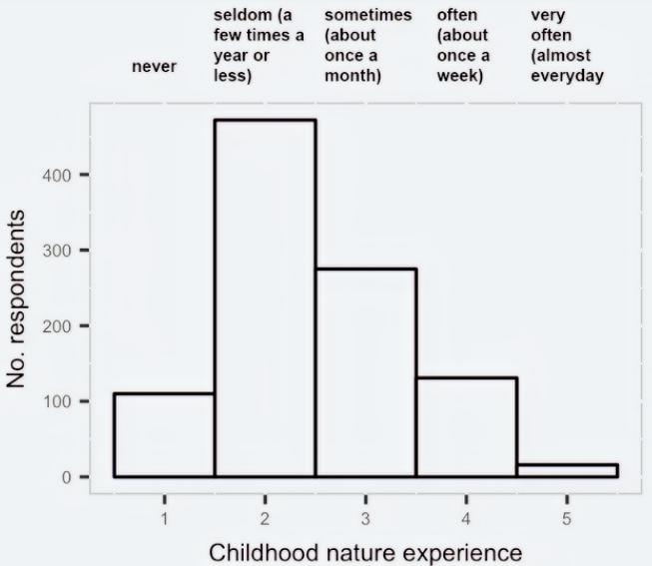
Survey about Childhood nature experience results

Slide 11
(Ngo et al, 2019, p. 3).
"Childhood nature experience has also been shown to have a positive relationship to environmental attitudes and behaviors"

Slide 12
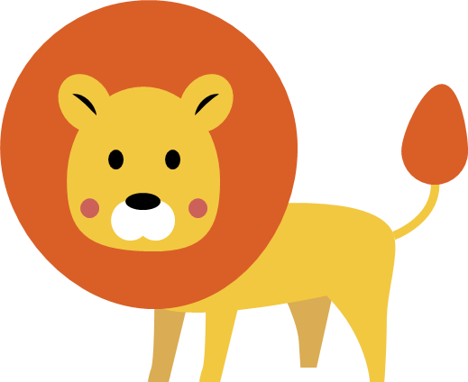
Conclusion
It is essential to remove the hostile impression human have toward wildlife because it could lead to negative activities toward wildlife.
Establishing effective wildlife management programs that educate and encourage the public starting from a young age to exhibit positive interactions with wildlife as a culture.
These actions are a forward step toward humans and animals coexisting.

Slide 13
Thank You

Slide 14

Reference
Contents:
Goumas, M., Lee, V. E., Boogert, N. J., Kelley, L. A., & Thornton, A. (2020). The Role of Animal Cognition
in Human-Wildlife Interactions. Frontiers in Psychology, 11.
https://doi.org/10.3389/fpsyg.2020.589978
Ngo, K. M., Hosaka, T., & Numata, S. (2019). The influence of childhood nature experience on attitudes and tolerance towards problem-causing animals in Singapore. Urban Forestry & Urban Greening, 41, 150–157. https://doi.org/10.1016/j.ufug.2019.04.003
Images:
[Dawn of the planet of earth]. (2011). https://static.wikia.nocookie.net/planetoftheapes/images/f/fe/Dawn_Rises_Poster.jpg/revision/latest?cb=20140606015409
[Animal Emoji]. (2021). Https://Www.Shutterstock.Com/Image-Vector/Set-Monkey-Emoticons-Funny-Show-Different-359132369.
[Wildlife Cartoon]. (2021). https://slidesgo.com/theme/world-wildlife-day

